Slide 1
PantherSoft User Experience (UI) Redesign
Employee & Manager - Webinar
July 17, 2018
Starting @10:00 a.m.
(No audio until we get started)

Slide 2
Agenda
PantherSoft User Experience Redesign
Project Objectives
Project Timeline
Project Website
FAQs
Homepages
Employee
Manager
HR Liaison
Navigator
Personalize Homepages
Wrap Up

Slide 3
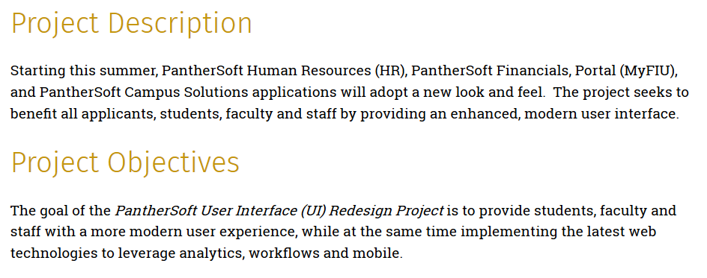
PantherSoft UI Redesign

Slide 4
PantherSoft UI Redesign

Slide 5
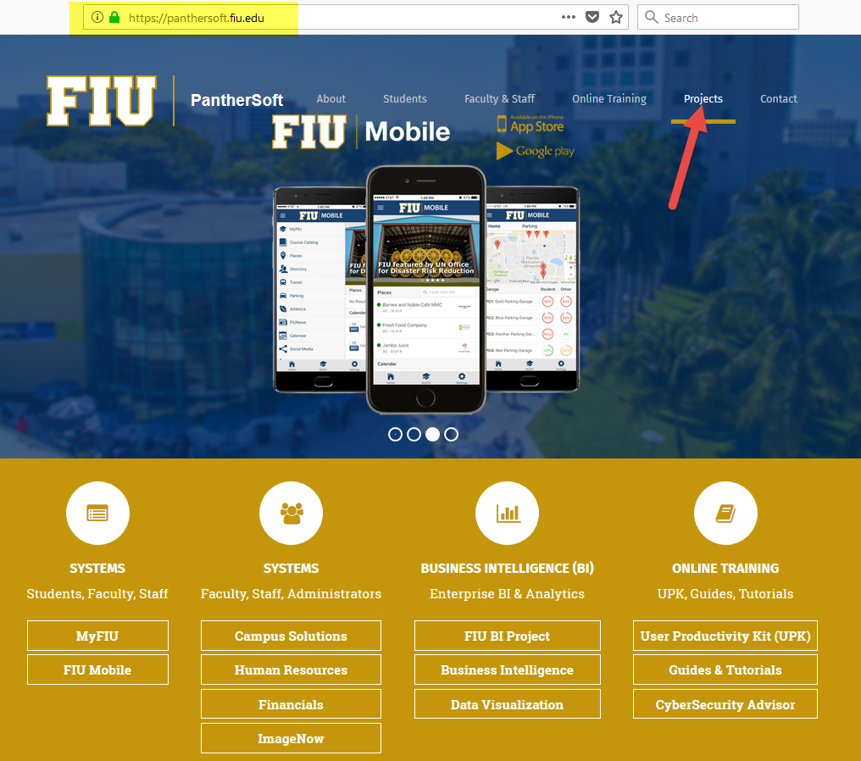

Slide 6
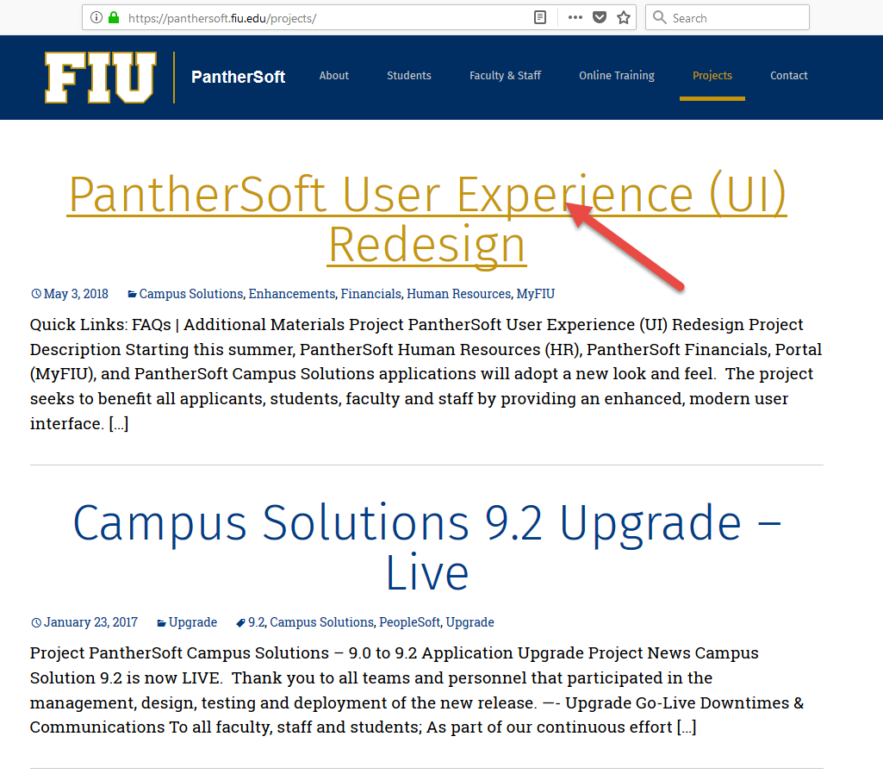

Slide 7
PantherSoft UI Redesign FAQ’s

Slide 8
Why are we redesigning the user interface?
The current PantherSoft user interface has been live for a number of years and has provided us with great value and stability, but there have been recent upgrades to the PantherSoft applications that provide the enhanced technologies that will allow FIU to implement and leverage a more modern design for all users.

Slide 9
How will the new user interface affect me?
Students, faculty & staff using MyFIU & Campus Solutions: In July, the only change to MyFIU will be the new navigation bar and “navigator” on the top right-hand side of the portal. The new user interface for MyFIU and Campus Solutions will be live in November of 2018.
Employees using MyFIU & Human Resources: In July, the only change to MyFIU will be the new navigation bar and “navigator” on the top right-hand side of the portal. However, Employee and Manager Self-Service, will be live with the new user interface.
Employees using MyFIU & Financials: In July, the only change to MyFIU will be the new navigation bar and “navigator” on the top right-hand side of the portal. Financials will begin using the new user interface in October of 2018

Slide 10
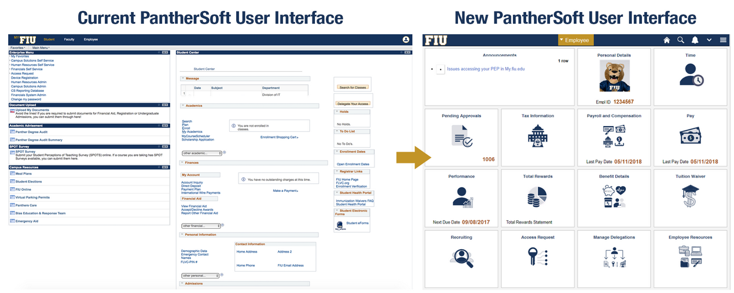
What is the new interface?

Slide 11
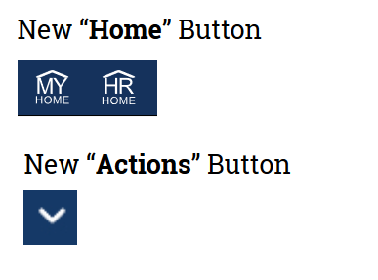
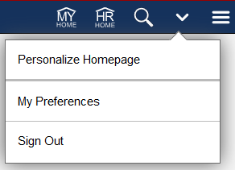
What is the new navigation?

Slide 12
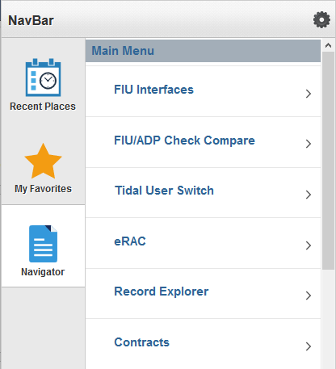
What is my menu?

Slide 13
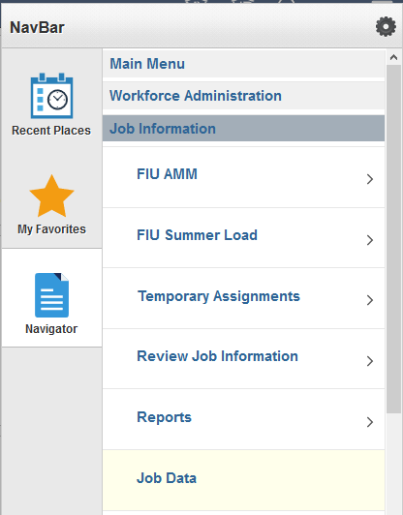
How do I use the Navigator?

Slide 14
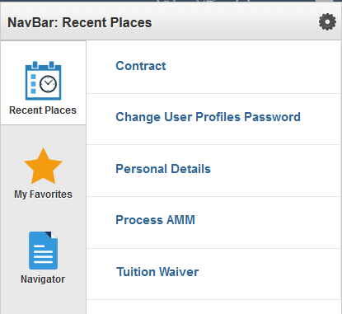
What are Recent Places?

Slide 15
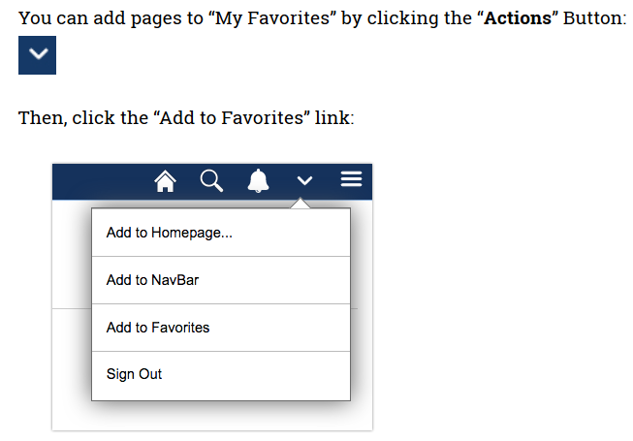
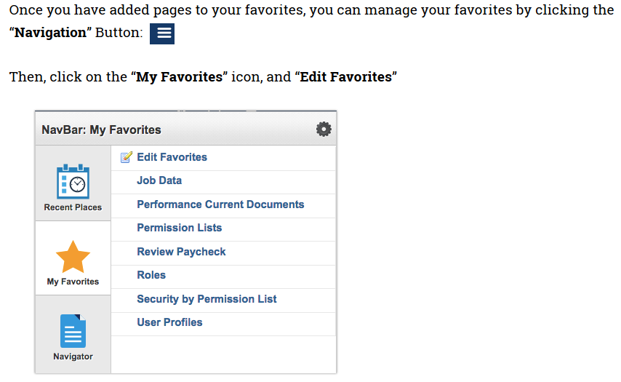
How do I manage My Favorites?

Slide 16
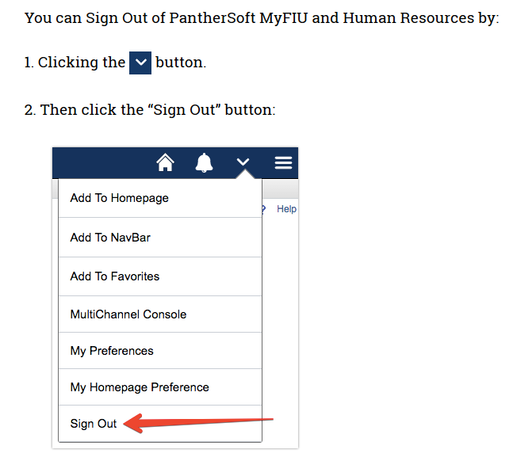
How do I Sign Out?

Slide 17
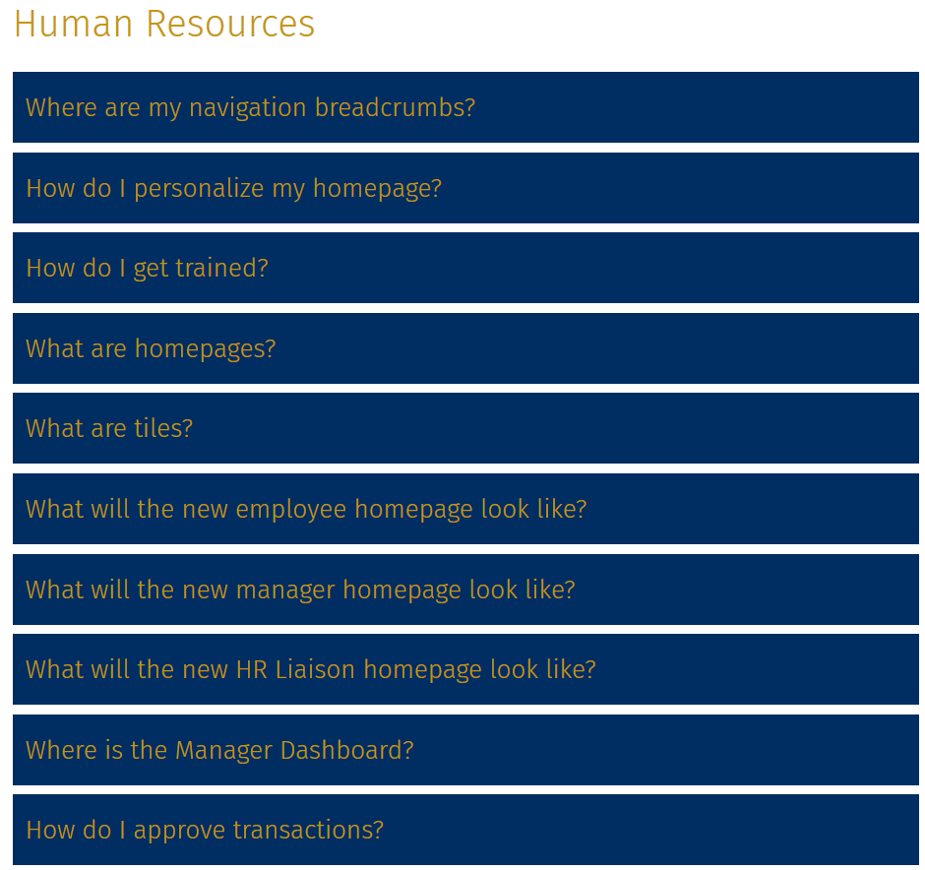
PantherSoft UI Redesign FAQ’s

Slide 18
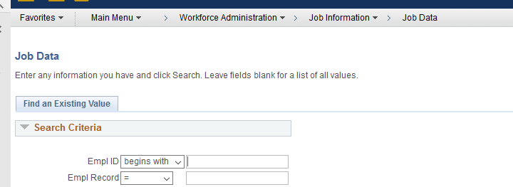
Where are my navigation breadcrumbs?

Slide 19
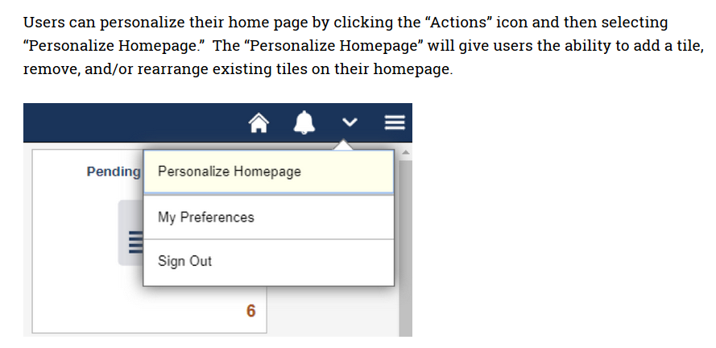
How do I personalize my homepages?

Slide 20
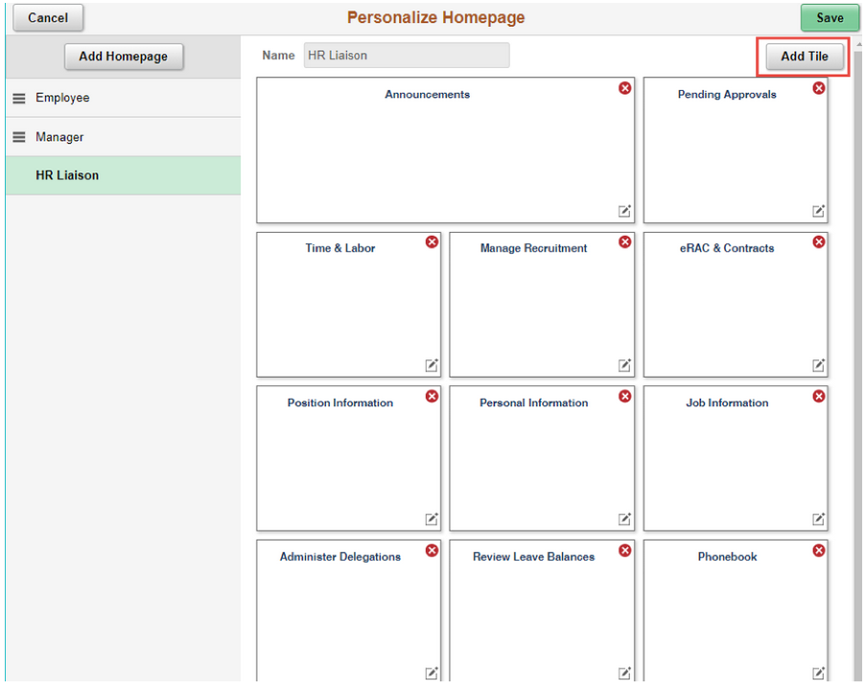
How do I personalize my homepages?

Slide 21
What are homepages?

Slide 22
What are tiles?

Slide 23
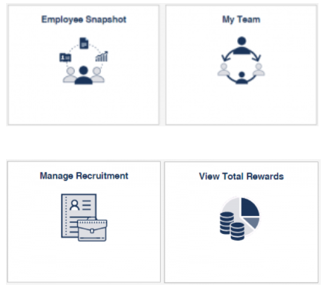
Where is the Manager Dashboard?

Slide 24
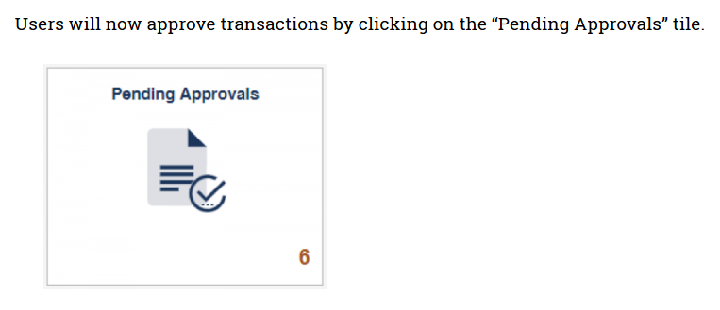
How do I approve transactions?

Slide 25
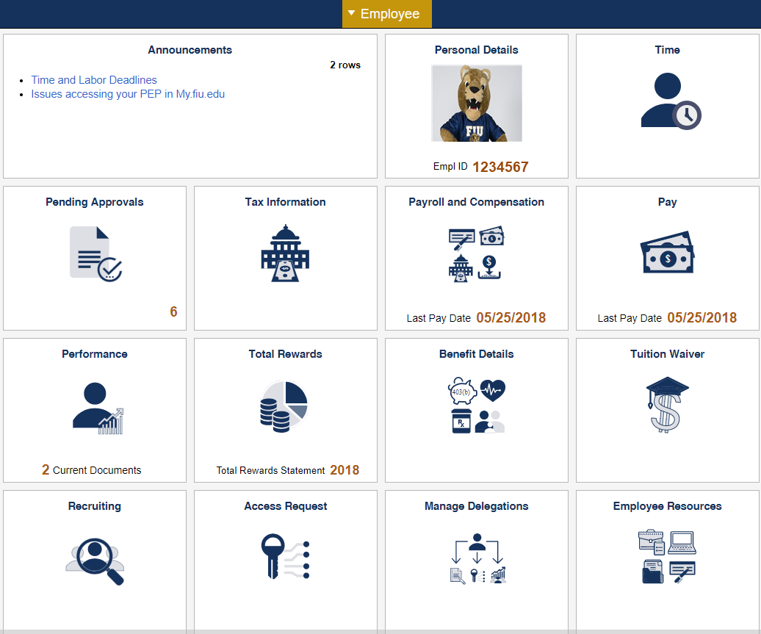
Employee Homepage

Slide 26
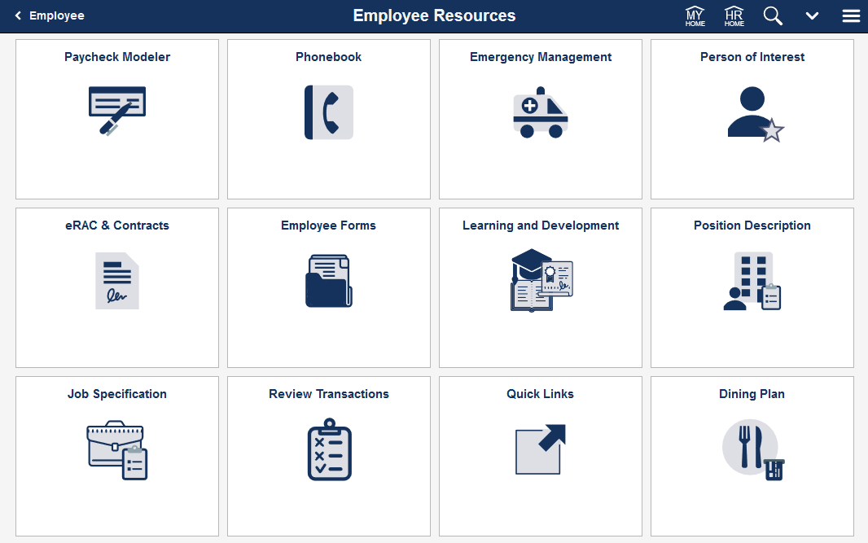

Slide 27
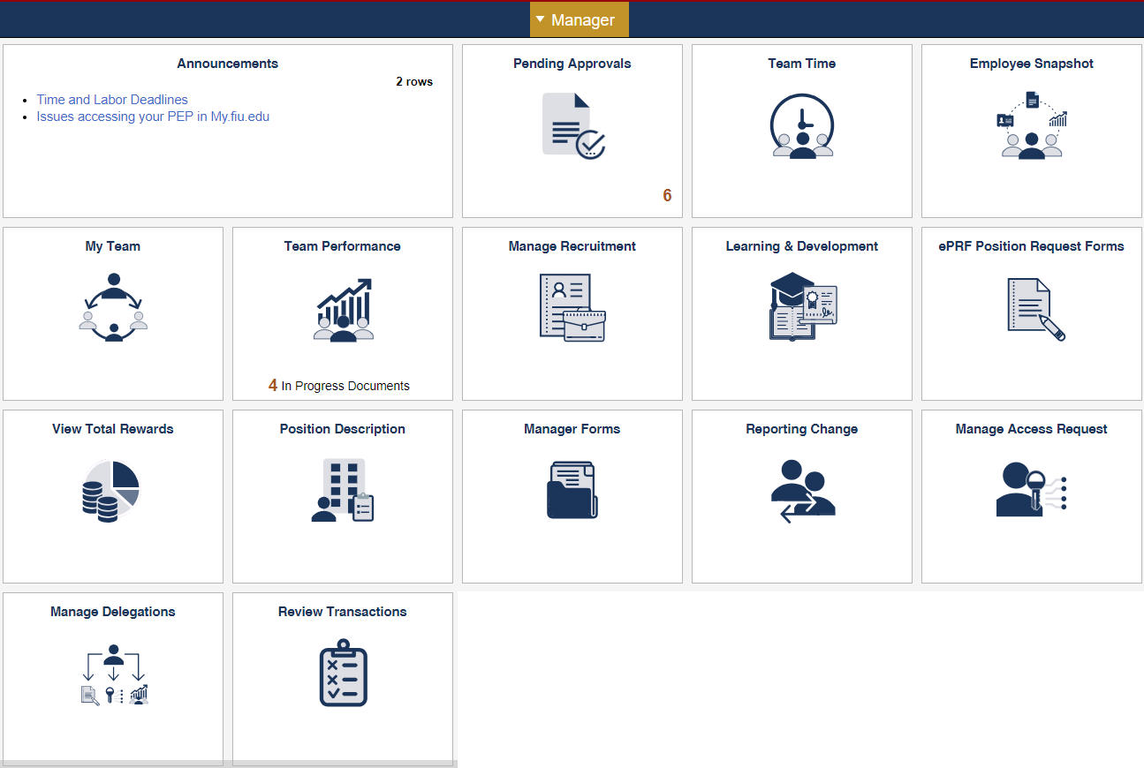
Manager Homepage

Slide 28
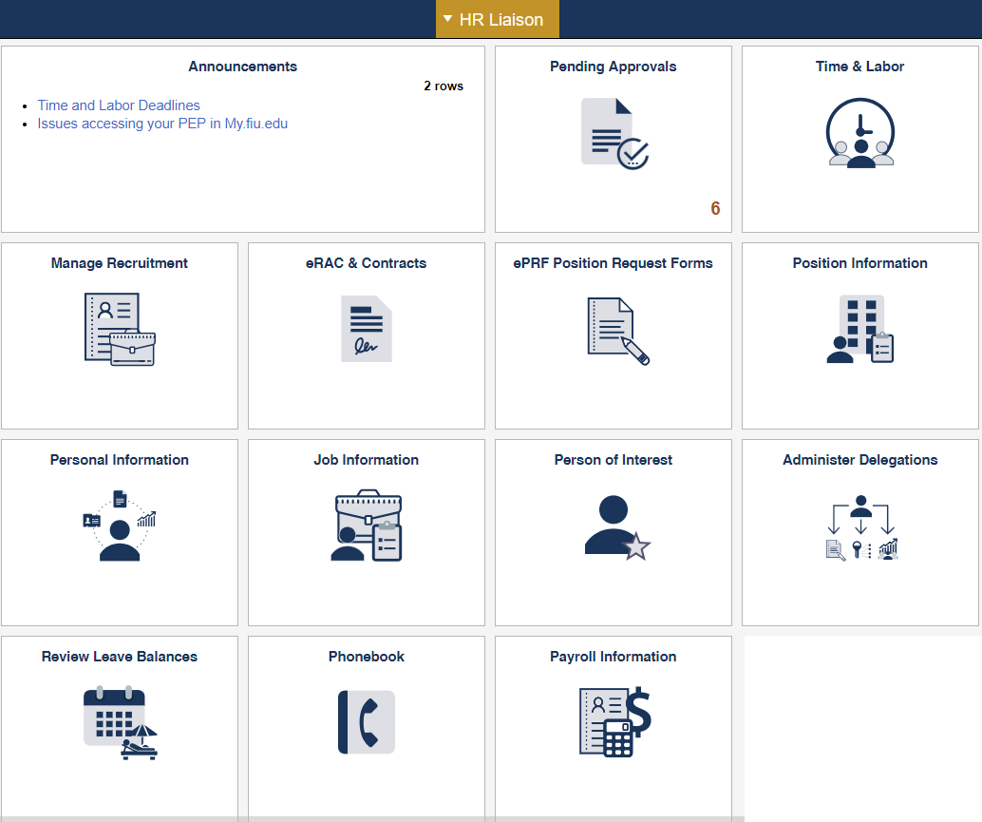
HR Liaison Homepage

Slide 29
Demonstration

Slide 30
Wrap up

Slide 31
Questions or Comments?

